Slide 1




American Retail Centre Geographies: Centres, Characteristics & Catchments
Patrick Ballantyne, Alex Singleton, Les Dolega, Jacob Macdonald
RGS-IBG Annual International Conference Summer 2021 [virtual]
@pj_ballantyne
Notes:
Introduce yourself
This presentation – working progress of the second paper from my PhD, a quantitative/geographic data science approach to understanding the geographies of American retail centres
N.B. methods focused, apologies!

Slide 2
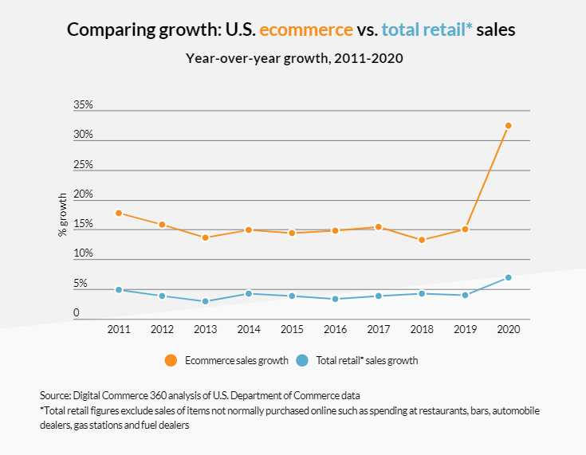
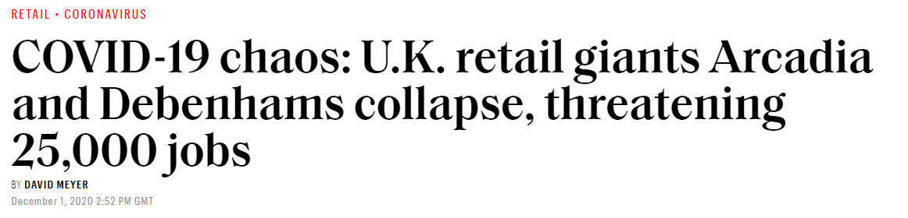
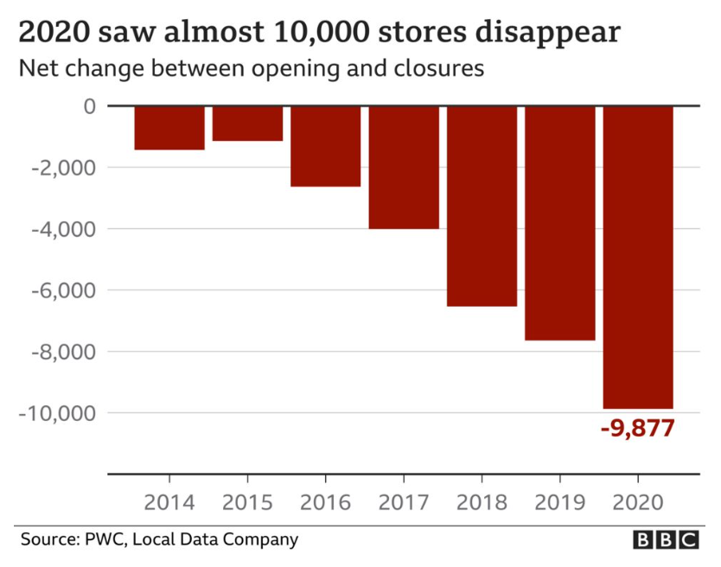

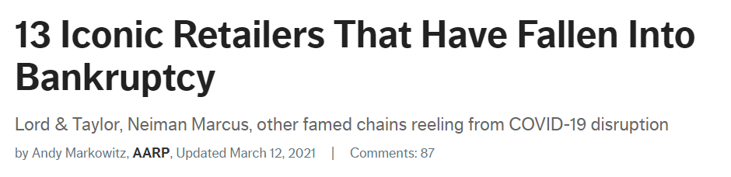
@pj_ballantyne
Notes:
Context: The retail sector faces many challenges – E-Commerce, increasing vacancy rates, COVID-19 pandemic, even talk of an ‘apocalypse’ in the US.
Why Care? Retail is vital for economic development of cities and regions, and in creating desirable places to live.
Retail Centres are the primary sites of consumption, so are inextricably linked to these issues… But they can also be useful tools for helping to mitigate against some of these challenges.

Slide 3
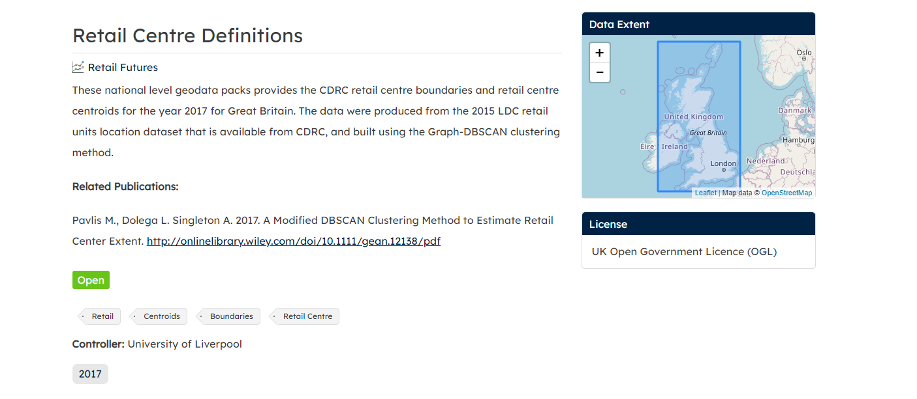
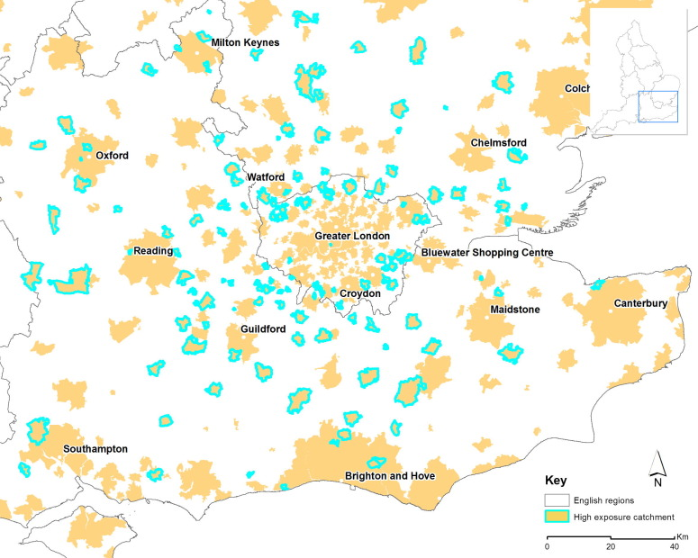

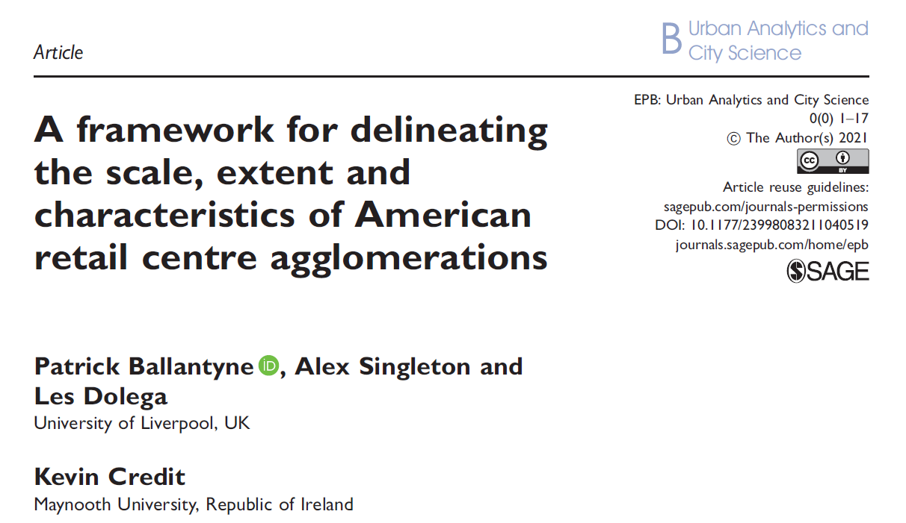
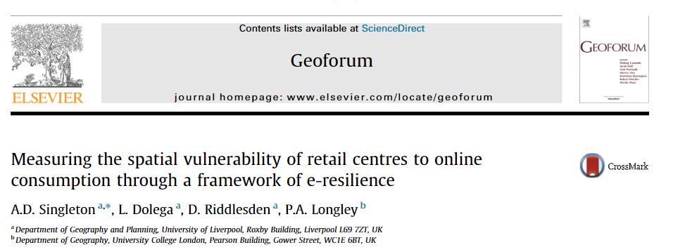
Ballantyne et al. (2021)
Singleton et al. (2016)
@pj_ballantyne
Notes:
We can use retail centres to assist:
Understanding past, present and future provision of Retail – helping to understand saturation, what the evolving trends in retail are etc.
Development of indicators/metrics to support better evidence-based decisions – E-Resilience example, COVID-19 example…

Slide 4
Ballantyne et al. (2021)
Singleton et al. (2016)
@pj_ballantyne
Notes:
Based on a recent paper of mine – framework introducing some of these concepts, methodologies etc. but tested for a metropolitan area of the US
Major contributions of this paper today – additional data, new methodologies, new geographical area, new aspect (catchments)

Slide 5
American Retail Centre Geographies: Centres, Characteristics & Catchments
The ‘where’
The ‘what’
The ‘who’
@pj_ballantyne
Notes:
So the objective of the paper is to get a comprehensive overview of the ‘geographies’ of retail centres
In retail geography literature these are understood through extraction of to get retail centres, characteristics and catchments
And I post this as understanding the WHERE, WHAT and WHO

Slide 6
American Retail Centre Geographies: Centres, Characteristics & Catchments
The ‘where’
@pj_ballantyne
Notes:
But in order to use them in such a way we must have a comprehensive understanding of their geographies, which first has to be achieved by defining their spatial extents – The ‘where’

Slide 7
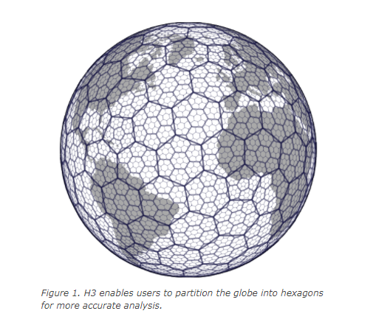

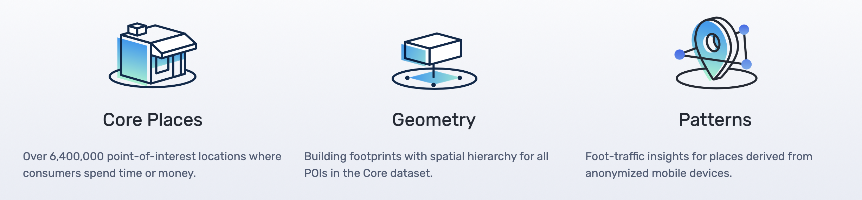

github.com/obrl-soil/h3jsr
@pj_ballantyne
American Retail Centre Geographies: Centres, Characteristics & Catchments
Notes:
Data: SafeGraph – Points (Core Places 3.5 million), Polygons (Building Geometries for the Core Places), extraction of retail-specific places.
Method: Using H3 – Hexagonal spatial index developed by Uber, method is relatively simple, offering advantage over other more complicated methods using spatial clustering

Slide 8

@pj_ballantyne
American Retail Centre Geographies: Centres, Characteristics & Catchments
Notes:
Summary:
Convert all spatial retail features to a H3 grid
Use graph objects and neighbouring relations with the H3 ‘k-rings’ to build up tracts of contiguous H3 addresses
Couple of other considerations made:
NHD used to ensure merging is restricted along major waterbodies
Only major centres are extracted – those w/ 50pts or more

Slide 9
@pj_ballantyne
American Retail Centre Geographies: Centres, Characteristics & Catchments
Notes:
Key Results:
10,958 Major Retail Centres identified.
98% in Metropolitan Areas of the US.

Slide 10
@pj_ballantyne
American Retail Centre Geographies: Centres, Characteristics & Catchments
Notes:
Key Results:
Few examples here of very different contrasting urban/retail environments
Notice variety in shapes/density of retail – particularly notice the Aventura Mall where use of OSM polygons has helped delineate full extent.
Validation – performed some validation against existing research, other datasets on retail distribution (e.g. employment clusters)

Slide 11
American Retail Centre Geographies: Centres, Characteristics & Catchments
The ‘what’
@pj_ballantyne
Notes:
So, when we have the centre definitions, the next stage in providing a comprehensive overview of retail centre geographies is to understand their position/role in the retail system – a typology.

Slide 12
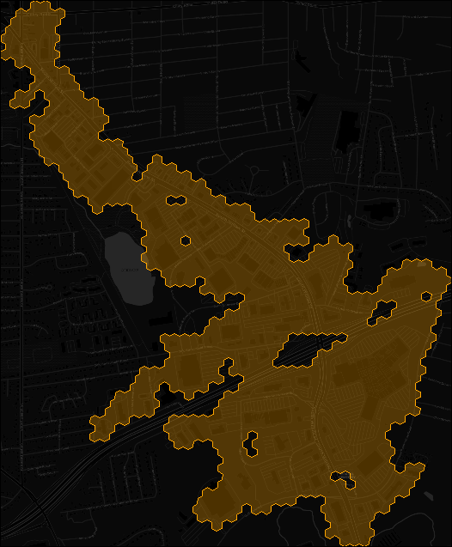
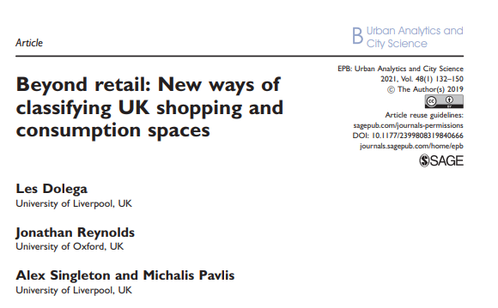
Size & Function
Size, shape, density (retail, residential, roads), employment density (retail & general), anchors, discount retailers, distance travelled, distance to transit.
Composition:
Balance of individual comparison, convenience, service and leisure retail categories.
Diversity:
Independents, small multiples, popular chains, retail category diversity (national & local).
Economic Health:
Visits, dwell times, local income patterns.
@pj_ballantyne
American Retail Centre Geographies: Centres, Characteristics & Catchments
Notes:
We gather a series of 37 variables identified as being key to understanding the functional differences between retail centres – using Dolega et al. (2019) and some of the comments received on Ballantyne et al. (2021), as well as using available data.

Slide 13
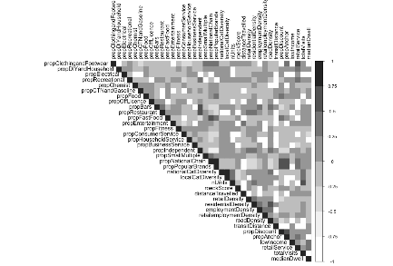
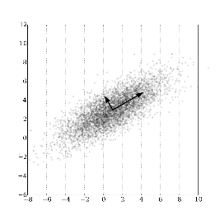
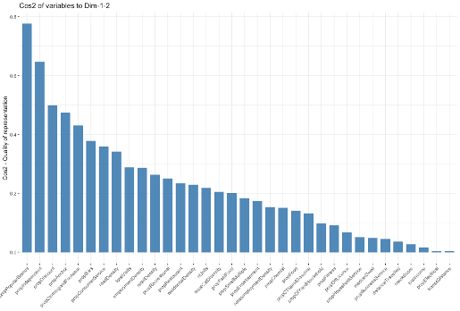
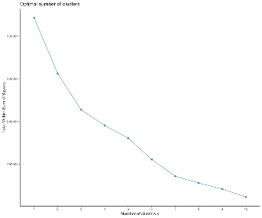
10,596 retail centres
Group 1
Group 2
Co-linearity
Sensitivity Analysis
Type 1
Type 2
Type 1
Type 2
Retail Centre Typology
37 Variables
31 Variables
PAM (1)
PAM (2)
Choosing k
Choosing k
k | Average Silhouette Score
2 | 0.091
3 | 0.067
4 | 0.055
5 | 0.026
6 | 0.031
7 | 0.037
8 | 0.027
9 | 0.025
@pj_ballantyne
American Retail Centre Geographies: Centres, Characteristics & Catchments
Notes:
This is the workflow of building the classification – in essence it involves dimensionality reduction (collinearity checks, PCA) and then construction of the classification using PAM – better than k means when input variables are heavily skewed – as is the case here!
Classification has two tiers – groups and nested types!

Slide 14
Group 1:
Abundant: bars, consumer & business services
Lots of independents, less popular chains
High density of roads, buildings
Away from retail employment clusters
@pj_ballantyne
American Retail Centre Geographies: Centres, Characteristics & Catchments
Notes:
So let’s take a look at the typology.
San Francisco was classified as a group 1 centre – overview of the key characteristics, using the median vals of each variable.

Slide 15
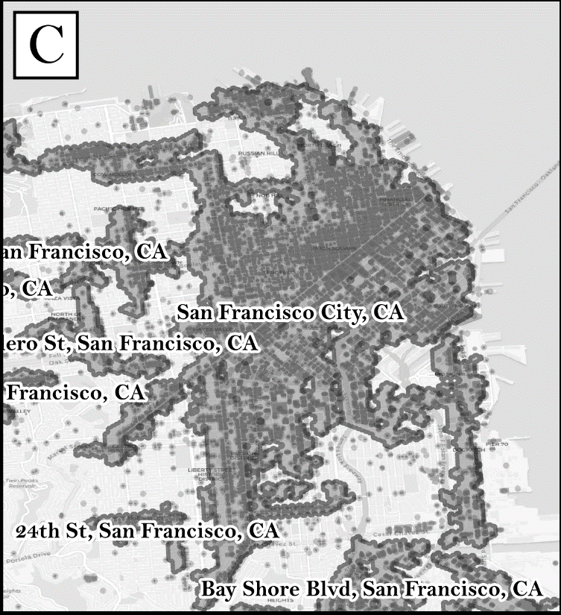
Group 1:
Abundant: bars, consumer & business services
Lots of independents, less popular chains
High density of roads, buildings
Away from retail employment clusters
Group 2:
Abundant: food, clothes/footwear, CTN/gasoline
Very diverse offering, lots of popular brands
Low density of roads, buildings
In clusters of retail employment
@pj_ballantyne
American Retail Centre Geographies: Centres, Characteristics & Catchments
Notes:
Very distinct contrast to group 2 centres – King of Prussia mall offers very different retail format to SF. Overview the characteristics.

Slide 16
Group | Type | Characteristics | Examples
1. Independent Urban Retail Centres | 1.1. Large City Centres and Downtown Districts | Largest in this group centres, located in areas with high road, residential and retail building densities. Centres comprise a high diversity of retail categories, and have an abundance of consumer services, restaurants and fitness facilities. | CBD's of major cities (e.g. San Francisco, Chicago, Houston, Boston).
 | 1.2. Secondary Urban Retail Centres and Main Streets | Abundance of independents and bars, with similarly high proportions of consumer services, business services and fitness facilities. These centres are typically more compact in morphology, but located in similar high-density (roads, buildings) urban areas, often at major intersections. | Cores of smaller neighbourhoods (e.g. Kenosha (WI), Portsmouth (NH), Tallahasee (FL), Fresno (CA).
2. Diverse Chain Retail Developments | 2.1. Established Comparison Shopping Destinations | High abundance of top 250 brands, anchors and discount retailers. These large retail centres are highly diverse, specialising in clothing/footwear, DIY/household and recreational goods. Visit frequencies to these centres are much higher, with people spending higher than average amounts of time here. | Major Malls (e.g. King of Prussia (PA), Aventura Mall (FL)), Woodfield Mall (IL), and major shopping districts in urban centres (e.g. Manhattan, Los Angeles, Las Vegas).
 | 2.2. Everyday Shopping Destinations (Strip Malls, Power Centres) | These smaller centres have a different offering to the other group, specialising in food-based retail, fast food, CTN and gasoline, with particularly high proportions of business services. High proportions of discount retailers are seen here, many of whom can be found on the list of top 250 retailers. | Along major roads and at major intersections. Examples include: South Bay Centre (MA), Mill Run Square (OH) and Pacific Crossroads (OR).
@pj_ballantyne
American Retail Centre Geographies: Centres, Characteristics & Catchments
Notes:
When we delve deeper into the nested types, even more interesting patterns emerge…
First group:
Clear distinction between big city retail centres, with those smaller urban centres – size, road/building densities and morphology
Second group:
Distinction between retail developments based on offering and morphology
This is all useful, because it gives a strong overview of the clustering of different types of retail in the US – e.g. Fitness in city centres? Business services and foot retail?
To be modified – weights re-arranged, additional variables??

Slide 17
American Retail Centre Geographies: Centres, Characteristics & Catchments
The ‘who’
@pj_ballantyne
Notes:
The final element is to understand who is using the retail centres themselves – an important task with lots of implications for better understanding drivers of retail decline – deprivation, internet engagement etc.

Slide 18
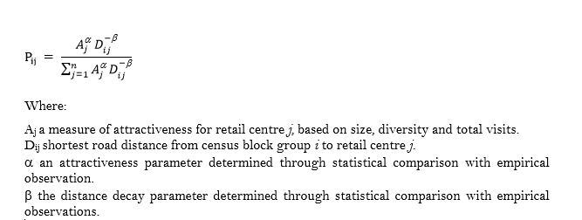
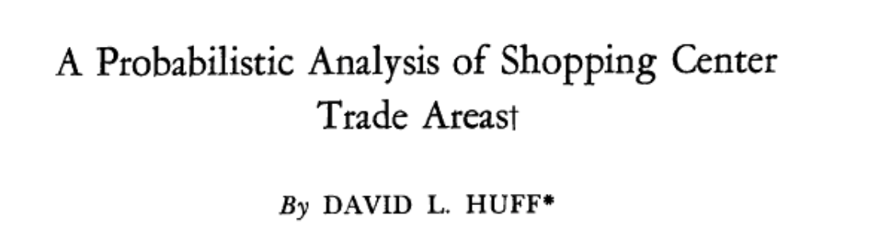
@pj_ballantyne
American Retail Centre Geographies: Centres, Characteristics & Catchments
Notes:
The Huff model has a long history in retail catchments – posited that consumer patronage/catchments can be modelled through consideration of the spatial location and attractiveness of retail destinations.

Slide 19


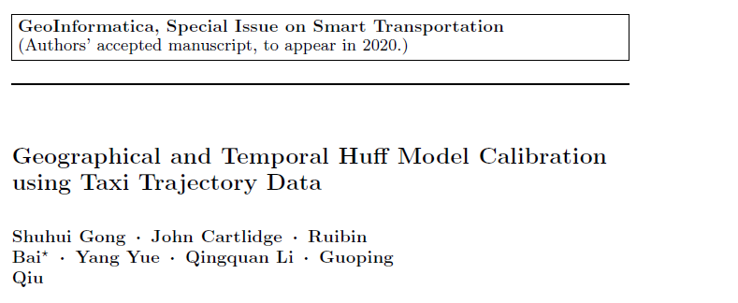
α = 1, β = 2
@pj_ballantyne
American Retail Centre Geographies: Centres, Characteristics & Catchments
Notes:
However, a problem with models like this is that the say how patronage ought to occur – rather than using empirical observations to model such behaviours.
In the model, the alpha and beta parameters are used to ensure the huff model accurately represents reality – by accounting for sensitivity to distance and attractiveness.
A wealth of literature is emerging that utilises such datasets to construct ‘observed’ patronage patterns and compare these with the ‘predicted’ ones from the Huff model – such studies are then able to calibrate the model parameters to ensure they provide an accurate representation of reality.

Slide 20
 | Pearson's R
 | 0.1 | 0.5 | 1.0 | 2.0 | 5.0
0.1 | - | - | - | - | -
0.5 | - | - | - | - | -
1.0 | - | - | - | - | -
2.0 | - | - | - | - | -
5.0 | - | - | - | - | -
α = 1, β = 2
@pj_ballantyne
American Retail Centre Geographies: Centres, Characteristics & Catchments
Notes:
In our case, we utilise the SafeGraph patterns data to collect ‘observed’ patronage for retail centres at Census Block Group level.
Then build a Huff model to predict the patronage – attractiveness (size, diversity of offer, total visits) and distance (road networks).
Test a range of alpha and beta values (at regional scale) to identify best, and then run for the US -> Stay tuned!

Slide 21

American Retail Centre Geographies: Centres, Characteristics & Catchments
Patrick Ballantyne, Alex Singleton, Les Dolega, Jacob Macdonald
Thanks for listening!
patrickballantyne/USRetailCentres
@pj_ballantyne

